Slide 2
About Today…
Overview
Features
Installation
Creating basic program

Slide 4
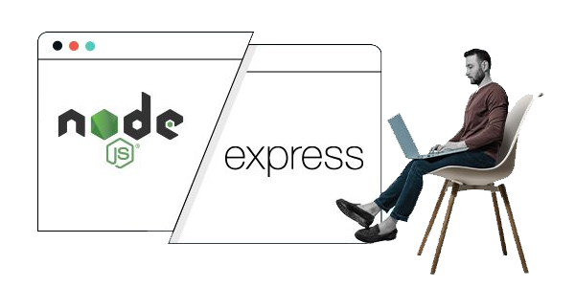
What is Express.js?
A web application framework for Node.js
Simplifies the process of building web applications
Provides robust features for web and mobile applications

Slide 5

Key Features of Express.js
Middleware support for handling requests
Integration with template engines for dynamic HTML
Simplifies server creation and management

Slide 6
Why Use Express.js?
Lightweight and unopinionated
Extensive ecosystem and community support
Easy to learn and integrate with other tools
Enhances productivity by reducing boilerplate code

Slide 7


Creating a Basic Express Application
Download and install Node.js from the official website
Verify installation by running :
node -v
npm -v
app.js
package.json

Slide 8


Creating a Basic Express Application
Initialize a new project:
Install Express
Create app.js file

Slide 9
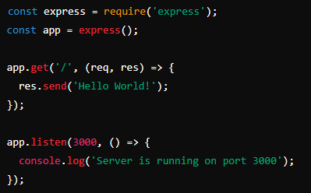


App.js
Start the server:

Slide 10
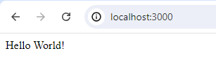
Access app
Access the application in a web browser

Slide 11
Basic Concepts in Express.js
Middleware
Functions that execute during the request lifecycle
Routing
Defines how an application responds to client requests
Template Engines
Tools for rendering dynamic HTML content

Slide 12

Introduction to Middleware
Definition
Middleware functions execute during the lifecycle of a request in Express.js.
Uses
For tasks like logging, parsing, authentication, etc.
Syntax
app.use()

Slide 13

Introduction to Routing
Definition
Route handlers manage HTTP requests
Uses
Define routes using app.get(), app.post(), etc
Syntax
app.get()

